Slide 1


New LJ Institute Of Engineering and Technology
Gujarat Technological University, Ahmedabad
Detection Of Drowsiness In Drivers
Head of Department
Dr. Gayatri Pandi
Guided by,
Prof. Prakruti Parmar
Prepared by,
Yanshu Patel(201430142022)
Hetvi Mudra(201430142073)
Vatsalkumar Bhimani(201430142019)

Slide 2
Outline
Introduction
Objective of project
Existing similar Project/Application study
Research Gap
Problem Summary
Canvas
Hardware/ software requirements
Modules
Features, Limitations & Future
Conclusion
References

Slide 3
INTRODUCTION
Driver fatigue is a major factor in a large number of vehicle accidents. Recent statistics estimate that annually 1,200 deaths and 76,000 injuries can be attributed to fatigue related crashes. The development of technologies for detecting and avoiding drowsiness at the wheel is a major challenge in the field of accident avoidance systems. Because of the hazard that drowsiness presents on the road, methods need to be developed for counteracting its affects.

Slide 4
Objective of project
The aim of this project is to develop a prototype drowsiness detection system.
The focus is on designing a system that will accurately monitor the open or closed state of the drivers eyes in real-time.
By monitoring the eyes, it is believed that the symptoms of driver fatigue can be detected early enough to avoid a car accident.

Slide 5
Existing similar projects
The existing similar project related to Drowsiness Detection System is:
Fatigue Detection using OpenCV- A computer vision system made with the help of opencv that can automatically detect driver drowsiness in a real-time video stream and then play an alarm if the driver appears to be drowsy.
AI For Road Safety- A Centralized WebApp to Ensure Road Safety by checking on with the activities of the driver and activating label generator using NLP.
Gesture Drive- An autonomous vehicle solution for people who are physically challenged, calibrates limb angle to drive steering wheel and operate pedals. Made by team Smoketrees for SIH 2020 and Mercedes Benz Hack 2020.

Slide 6
Research Gap
SR NO | PAPER TITLE | PAPER AUTHOR | PUBLISHED YEAR | SUMMARY
1. | Driver drowsiness detection system | Belal Alshaqaqi, Mokhtar Keche | 19 September 2013 | In this paper, a module for Advanced Driver Assistance System (ADAS) is presented to reduce the number of accidents due to drivers fatigue and hence increase the transportation safety; this system deals with automatic driver drowsiness detection based on visual information and Artificial Intelligence. We propose an algorithm to locate, track, and analyze both the drivers face and eyes to measure PERCLOS, a scientifically supported measure of drowsiness associated with slow eye closure.
2. | Driver Drowsiness Detection and Alert System | Swapnil Titare, Shubham Chinchghare, K.N.Hande | June, 2021 | Nowadays, accidents occur during drowsy road trips and increase day by day; It is a known fact that many accidents occur due to driver fatigue and sometimes inattention, this research is primarily devoted to maximizing efforts to identify drowsiness. State of the driver under real driving conditions. The aim of driver drowsiness detection systems is to try to reduce these traffic accidents.

Slide 7
Problem summary
The problems occurring are :
Lack on road data
Inconsistent protocols for data collection
Subjective and incoherent labelling of drowsiness
Aging of sensors used in system
Using 2 cameras, one for monitoring and another for face expressions

Slide 8
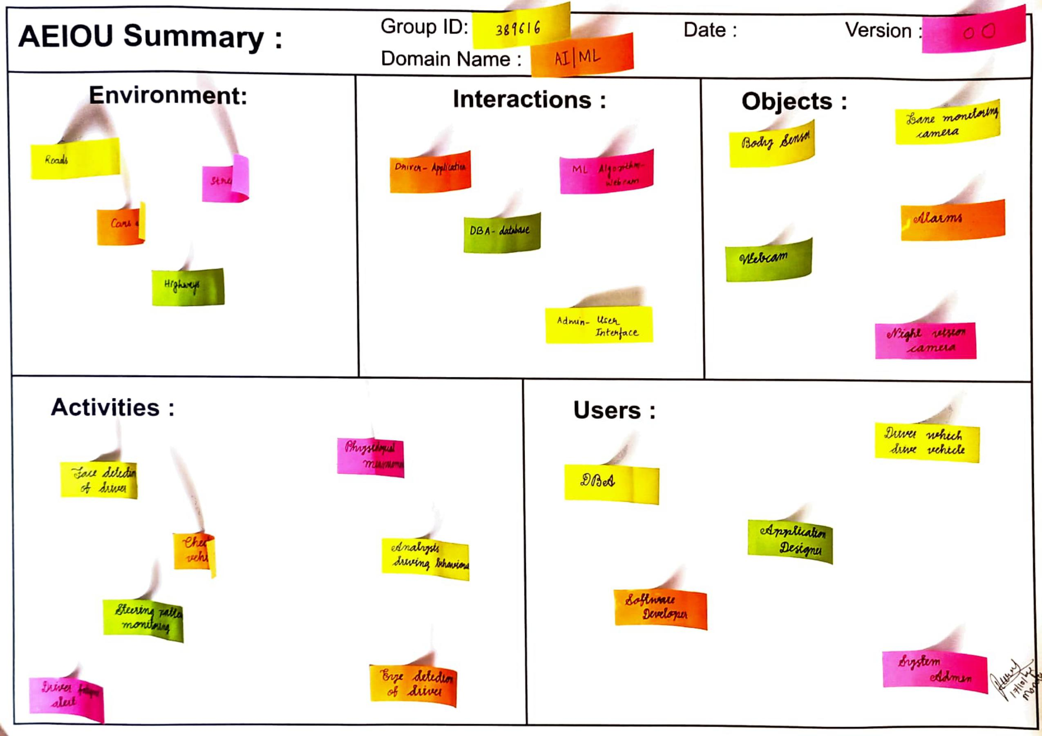
AEIOU CANVAS

Slide 9
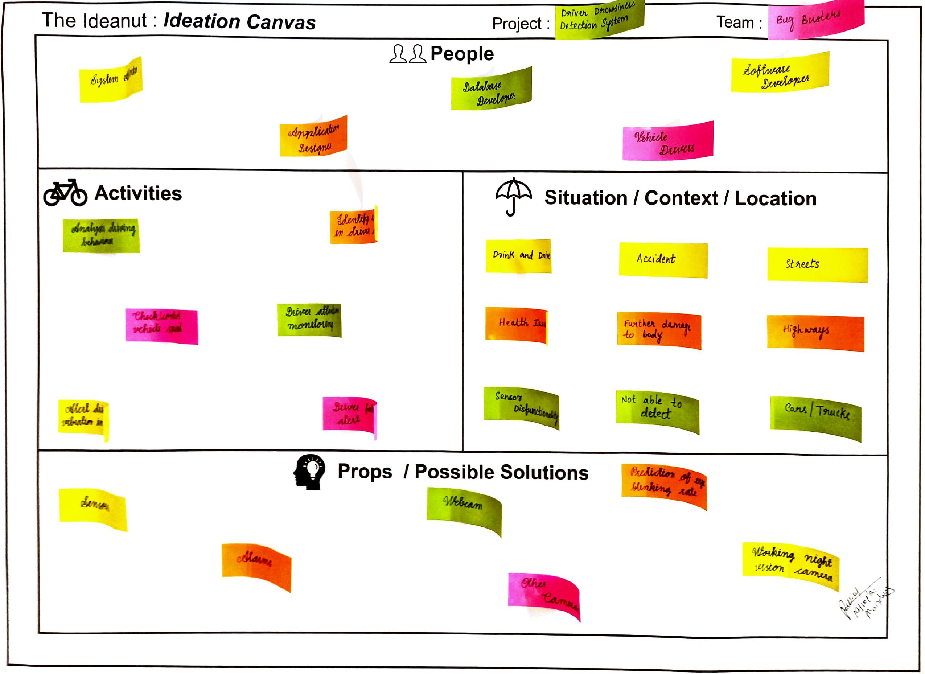
IDEATION CANVAS

Slide 10
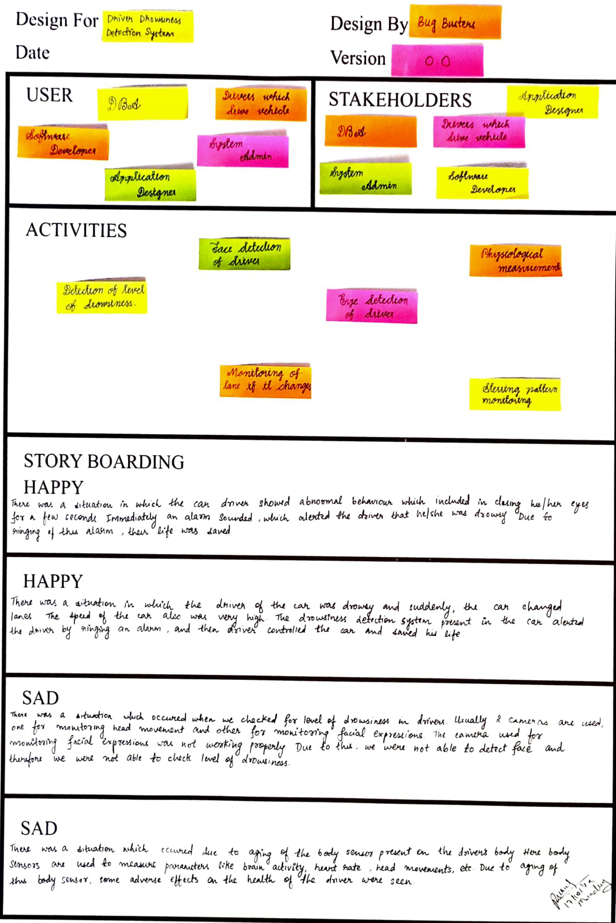
EMPATHY CANVAS

Slide 11
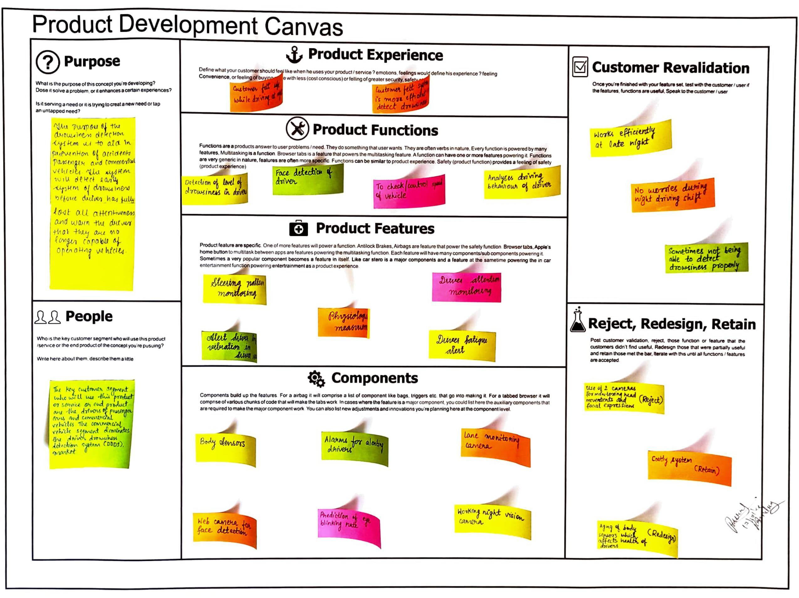
PRODUCT DEVELOPMENT CANVAS

Slide 12
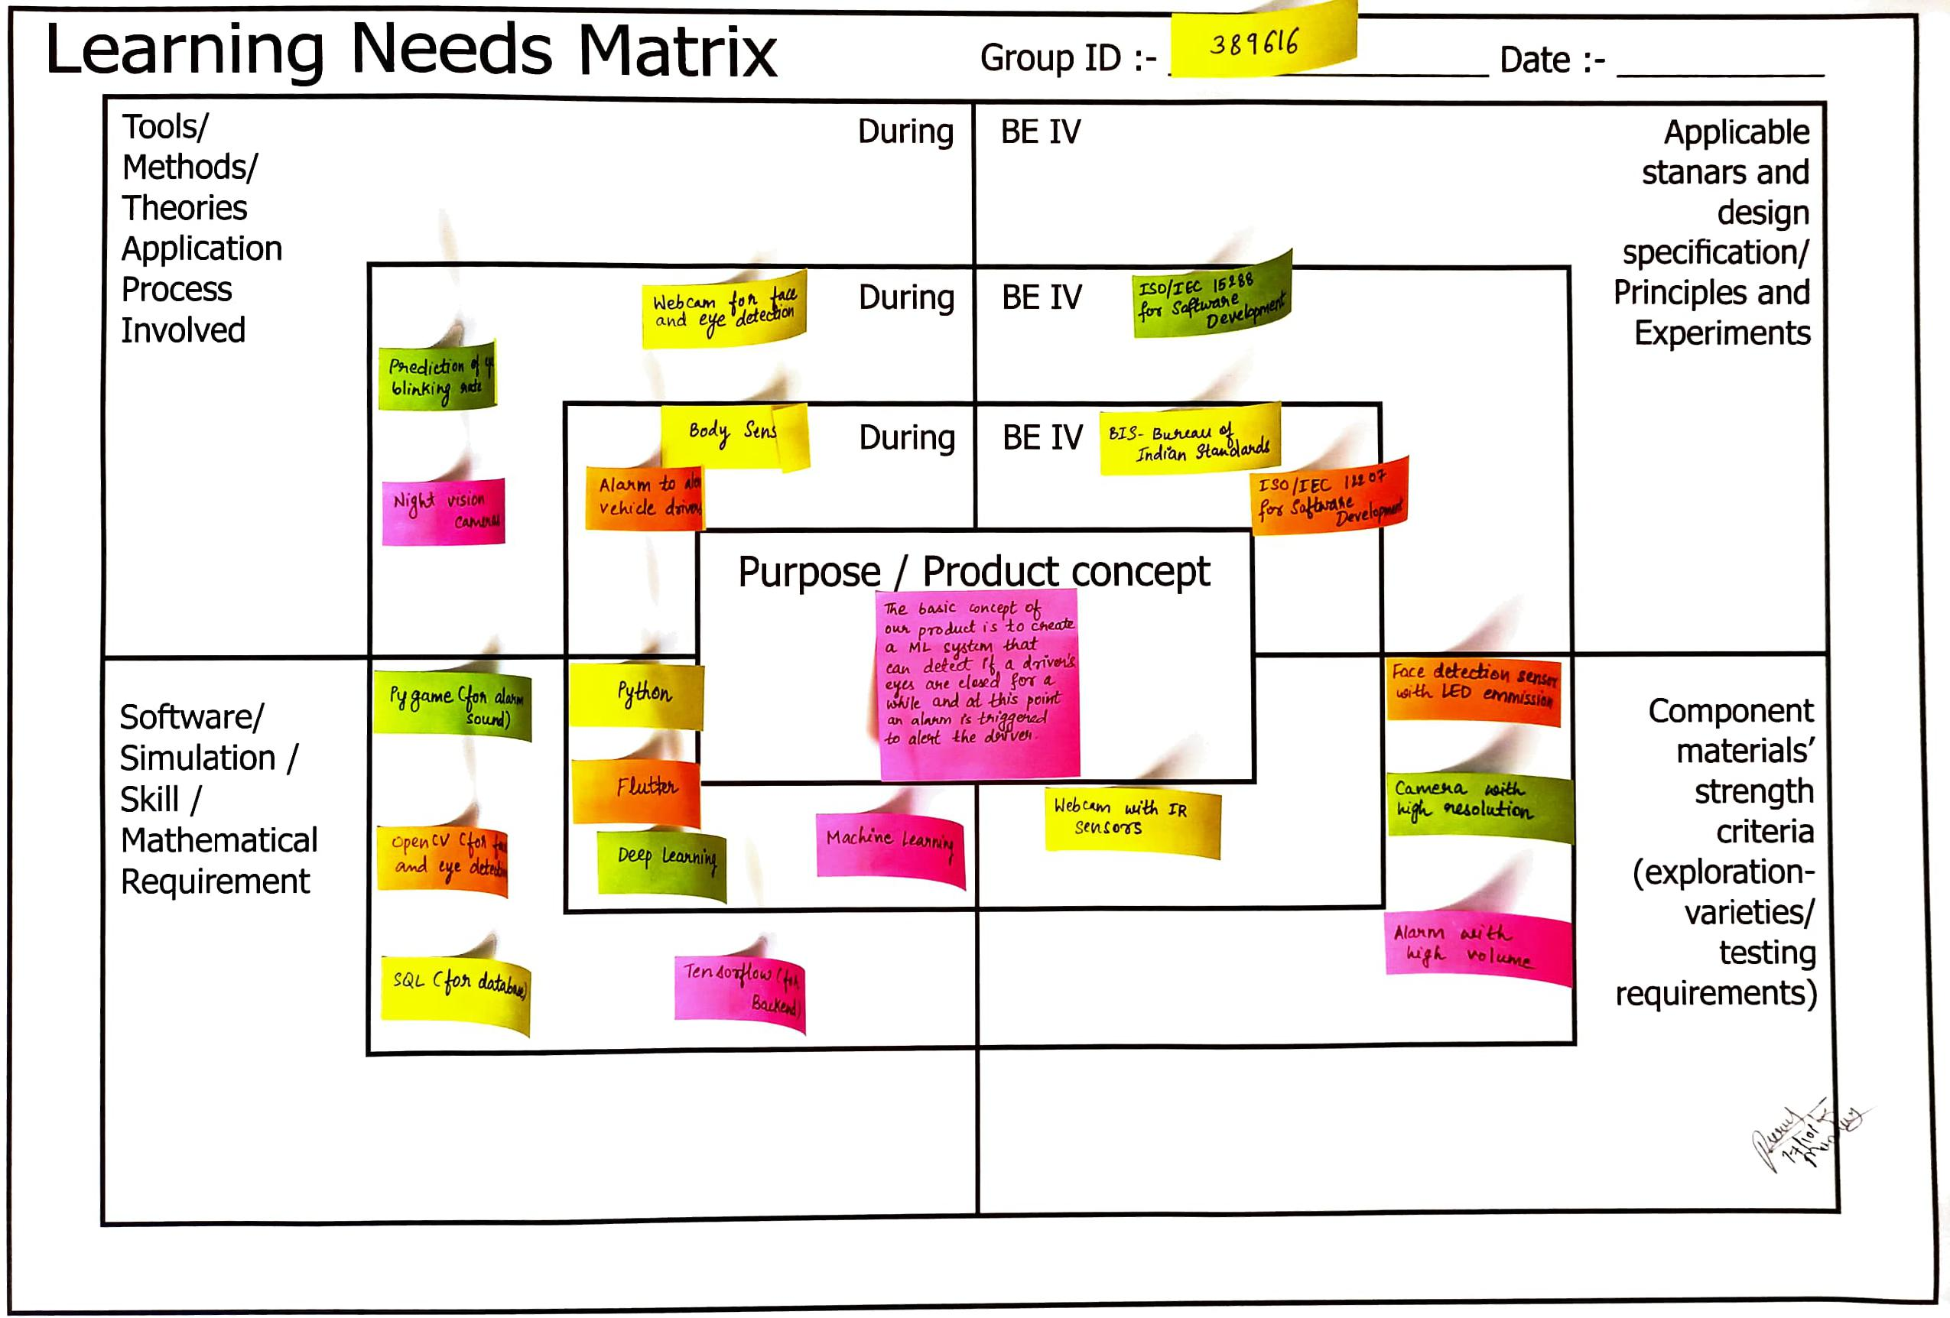
LNM CANVAS

Slide 13
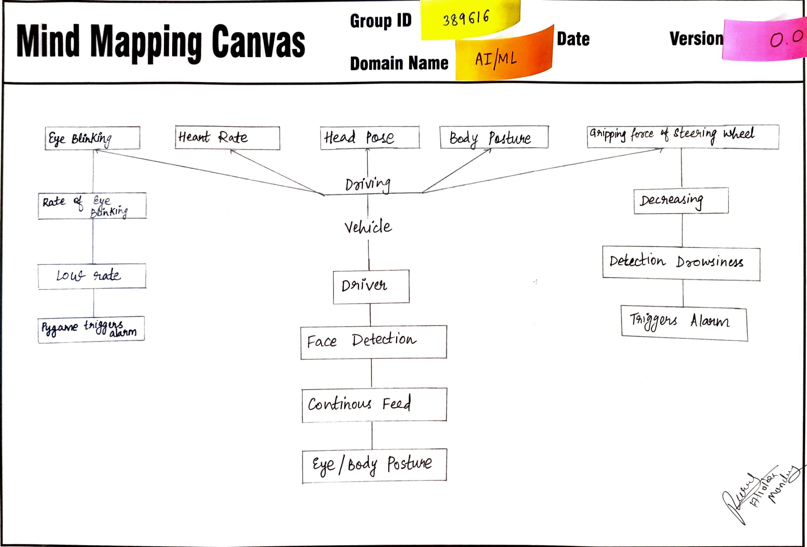
MIND MAP

Slide 14
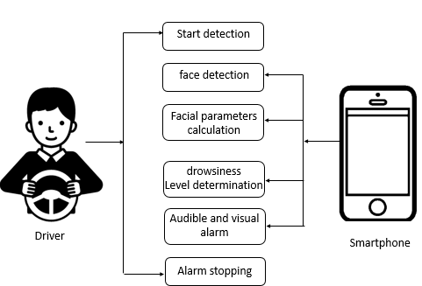
PROTOTYPE

Slide 15
HARDWARE/ SOFTWARE REQUIREMENTS
Hardware Requirements are:
Webcam with IR sensors
Face detection sensors with LED emission
Body sensors
Night vision cameras
Alarm to alert vehicle drivers
Software Requirements are:
Machine Learning and Deep Learning
Python
Playsound(for alarm sounds)
OpenCV(for face and eye detection)

Slide 16
MODULES
ML Engineer- model development(training and testing model)
Application Developer
Drivers- potential user of application

Slide 17
FEATURES, LIMITATIONS AND FUTURE SCOPE
The features of this project are:
Simple application of Image processing
Image processing based drowsy detection
Real time video capturing and image processing
Buzzer for alarm indication

Slide 18
The limitations of the project are:
Image processing achieves highly accurate and reliable detection of drowsiness.
Image processing offers a non-invasive approach to detecting drowsiness without the annoyance and interference.
A drowsiness detection system developed around the principle of image processing judges the drivers alertness level on the basis of continuous eye closures.

Slide 19
This technology is still in the early research stage of development. Based on the work completed thus far, following modifications can be implemented:
Capture individual drivers steering activity while drowsy
Conduct additional simulator experiments to validate the algorithm, test additional road conditions
Test and refine the algorithm based on the road test data, and conduct research on warning systems integrated with the detection system.

Slide 20
CONCLUSION
It completely meets the objectives and requirements of the system. The framework has achieved an unfaltering state where all the bugs have been disposed of. The framework cognizant clients who are familiar with the framework and comprehend it's focal points and the fact that it takes care of the issue of stressing out for individuals having fatigue-related issues to inform them about the drowsiness level while driving.

Slide 21
REFERENCES
Weirwille, W.W. (1994). Overview of Research Driver Drowsiness DefinitionDriver Drowsiness Detection,14th International Technical Conference on Enhanced Safety of Vehicles, pp 23-26.
Neeta Parmar Instructor: Peter Hiscocks, "Drowsy Driver Detection System" Department of Electrical and Computer Engineering", presented at Ryerson University Â© 2002.
Singh, Sarbjit and Papanikolopoulos, N.P. Monitoring Driver Fatigue Using Facial Analysis Techniques,IEEE Intelligent Transport System Proceedings (1999), pp 314-318
Gonzalez, Rafel C. and Woods, Richard E. Digital Image Processing, PrenticeHall: Upper Saddle River, N.J., 2002.

Slide 22
THANK YOU

